Slide 1
Evidence Of Evolution
Chapter 28

Slide 2
What is evolution?
Evolution can be simply stated as
Change over Time
More elaborate:
It is how different kinds of organisms are thought to have developed and diversified from earlier forms during earths history

Slide 3
B. Evidence from Living Things

Slide 4
Homologous Structures
Skeletal structure of different organisms have:
similar structure and embryological development
different forms and function

Slide 5
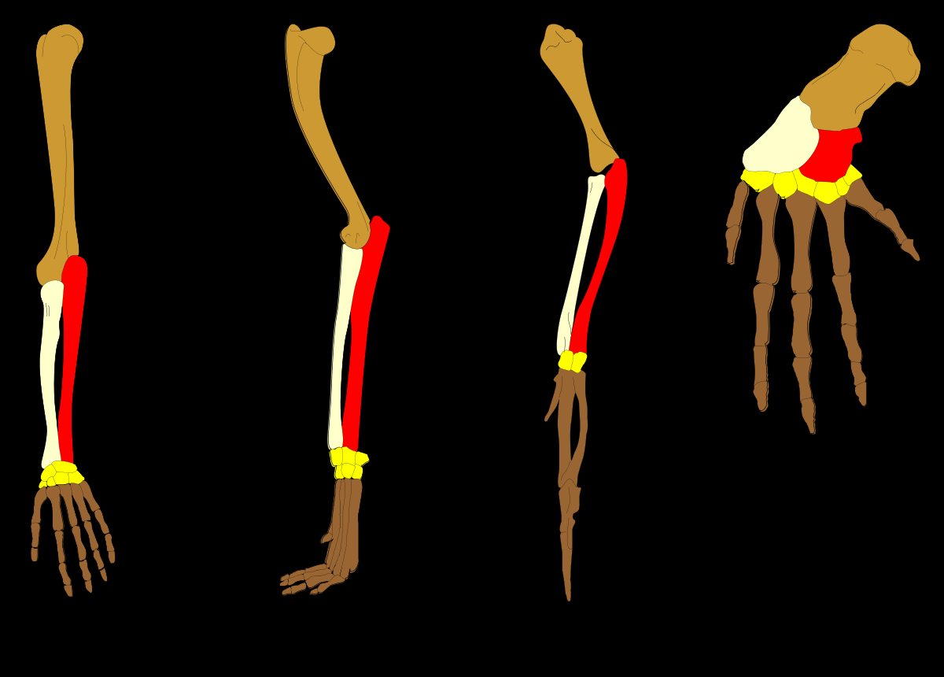
Examples

Slide 6
Analogous Structures
Similar external forms and similar function
but different internal structures

Slide 7
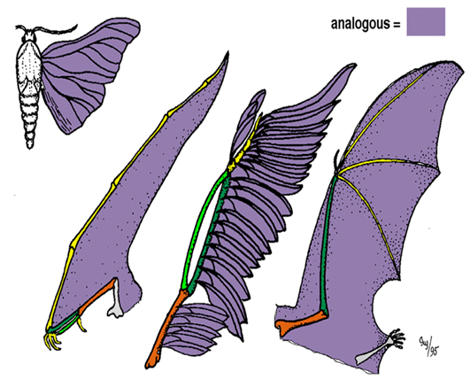
Analogous Examples
All have a external wing for flight, but the internal structure is not similar

Slide 8
Vestigial Structures
Structures that were functional in an ancestral form but are no longer functional
They are reduced forms that no longer serve a function

Slide 9
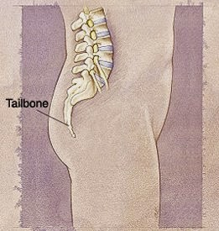
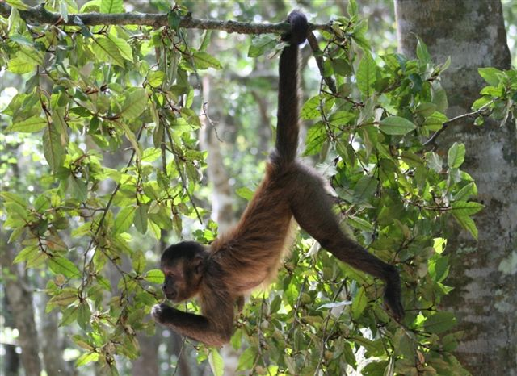
Vestigial Examples

